Slide 1


Integrating Machine Learning with OCR and NLP into Underwriting
RGA Improves Its Industry-Leading Underwriting Process
Jeff Heaton, Ph.D., VP Data Science, RGA
May 4, 2022

Slide 2
Presentation Overview
The technology behind RGA’s FAC Optimization system
Amazon Textract machine-learning service from AWS featuring:
State-of-the-art Optical Character Recognition (OCR) AI that can find patterns and images
Natural Language Processing (NLP) to mine text for sequences of words
Delivering digitized data in a concise, easy to understand format to assist underwriters
The MLOp’s pipeline:
Models developed by RGA data science team in Domino Datalab
Built into Docker containers using AWS technologies
Lambda
Faregate
S3
CloudWatch
Textract
Notes:
RGA utilizes a Facultative (FAC) Underwriting optimization solution featuring Amazon Textract, a machine learning service from Amazon Web Services (AWS) that uses optical character recognition (OCR) to extract text, handwriting, and data from scanned documents. By integrating machine learning, state-of-the-art OCR, and natural language processing (NLP) technology into the underwriting process, RGA is continuing to find ways to innovate underwriting and risk selection by augmenting its already industry-leading facultative underwriting process.
RGA is the worldwide leader in facultative reinsurance, or individual large-case underwriting and substandard risk assessment. Now through the addition of OCR, a form of AI that can find patterns and images, and NLP, which can mine text for sequences of words, information can be digitized and converted into a more concise, easily understandable format to assist underwriters.
The MLOps pipeline begins with models developed by our data science team in Domino Datalab. These models are built into Docker containers and deployed to a system using AWS technologies, including Lambda, Faregate, S3, CloudWatch, and Textract. This presentation will introduce the technology behind the RGA FAC Optimization system, highlighting how we were able to create a scalable, reliable method to optimize parts of our underwriting system.

Slide 3
Jeff Heaton, Ph.D.
jheaton@rgare.com
VP, Data Science at RGA
Adjunct Instructor, Washington University in St. Louis (Deep Learning)
Machine Learning YouTuber with 65K+ Subscribers
Fellow of the Life Management Office (FLMI)
Senior Member of IEEE and Member of ACM

Slide 4

RGA Overview

Slide 5
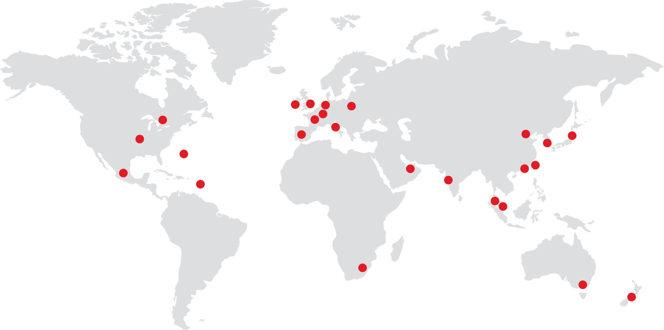
Operations in Key Markets Globally
RGA is a global leader serving multinational and domestic clients in more than 80 countries.

Slide 6

Global Life and Health Reinsurers
Ranked by 2020 revenues
$ in millions as of December 31, 2020
Rank | Reinsurer | Revenues
1 | Swiss Re | 15,440
2 | Reinsurance Group of America¹ | 14,636
3 | Munich Re² | 12,032
4 | SCOR Global Life Re | 9,899
5 | Hannover Re | 8,982
¹ Adjusted operating revenues.
² Estimate, excludes Munich Health.
Please note: Exchange rate conversions are based on currency rates provided by each company in their annual filings.
Source: Annual filings for each reinsurer.

Slide 7
Individual and Group Risk Solutions
Mortality
Critical illness
Health/Medical
Disability income
Long-term care
Personal accident
Longevity
Takaful
RGA Traditional Reinsurance

Slide 8
Underwriting for Reinsurance

Slide 9
Reinsurance Terminology
Cessions, Treaties, and more
Ceding Company
An insurance company transferring risk
Reinsurance Company
An insurance company that assumes risk from a ceding company
Direct Writer/Insurer
The insurer that generally directly sells a life insurance policy to the public
Treaty
Essentially a contract between two insurance companies to transfer risk
Cession
An individual risk (generally a policy) transferred from a ceding company to a reinsurance company

Slide 10


What is Life Reinsurance?
Multiple insurers share risk of individual and group policies
Life
Policy
Direct
Insurance
Company
Reinsurance
Companies

Slide 11
Retrocession Structure
Automatic, Facultative, and Facultative Obligatory
Automatic Treaty
Ceding company must cede all policies that meet criteria, and the reinsurer must accept these policies
Facultative Treaty (the focus of this talk)
Reinsurer underwrites proposed policies and either rejects or issues a quote
Facultative Obligatory Treaty
A hybrid of automatic and facultative

Slide 12

What is the RGA FAC Optimization Process?

Slide 13
Facultative Reinsurance Quotes
We seek to optimize the facultative process
RGA USA accepts facultative cases from our ceding company clients at anytime; however, most are within business hours
Some cases we can quickly decline, allowing us to focus on cases that we might accept
Underwriting requires the time of underwriters, support staff, medical directors, team managers, etc.
RGA is only paid for those cases in which:
We determine the case represents an acceptable risk and we make a reinsurance offer
The ceding company accepts our reinsurance offer
The proposed insured accepts the rating/offer, and the policy is issued and placed inforce

Slide 14
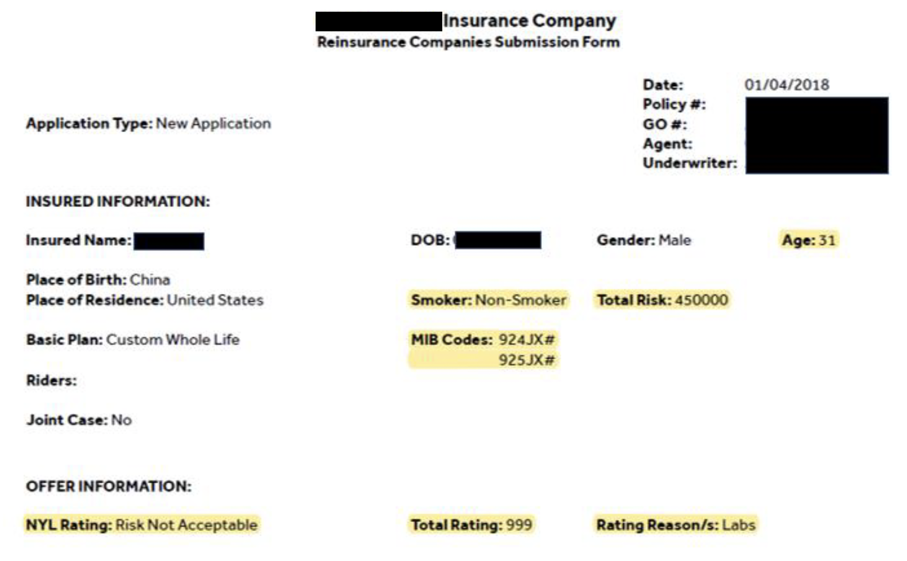
Life Insurance Policies
RGA sees large numbers of scanned documents

Slide 15

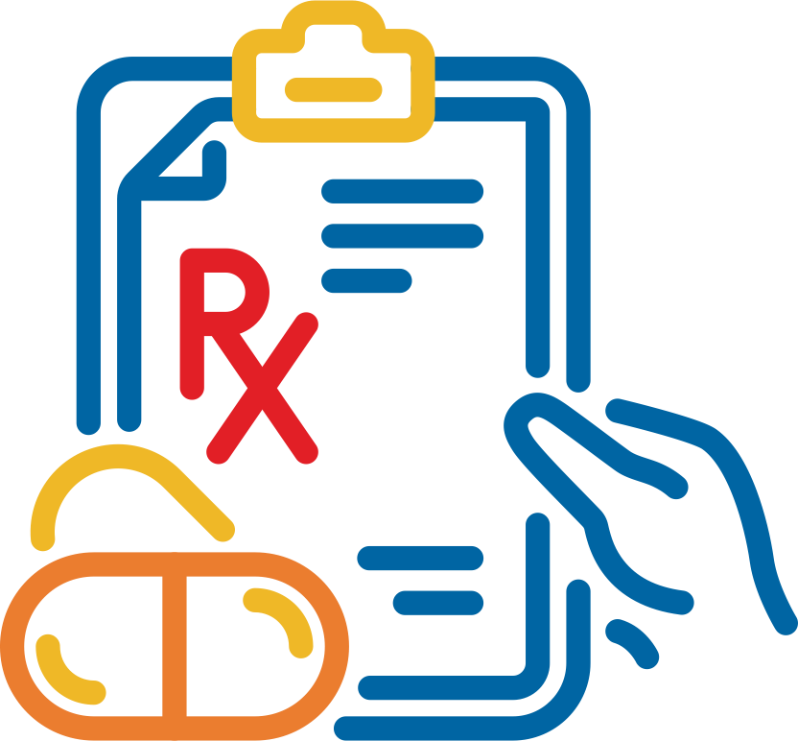
Data Extracted
Valuable data is often trapped in unstructured form
Insurance Application (parts 1 & 2)
Labs (Blood and Urine ‒ A1C, BUN, cholesterol, etc.)
Attending Physician Statement (APS) records
Prescription history
Vital signs
Alternative data sources

Slide 16
Models vs Heuristics
Don’t overengineer the problem
Some disclosures and lab results are immediate declines
We do not need a model to learn obvious rules
Models can consider complex multi-variate comorbidities
Most unaided human analysis can only consider a handful of variables
OCR transforms scanned pages to text
Text is extracted from pages as rectangles of near-proximity text
NLP extracts collections of name-value pairs from text
Some data are simple name-value pairs, such as date of birth or name
Some data are collections of name-value pairs, such as lists of drug codes and dosages

Slide 17
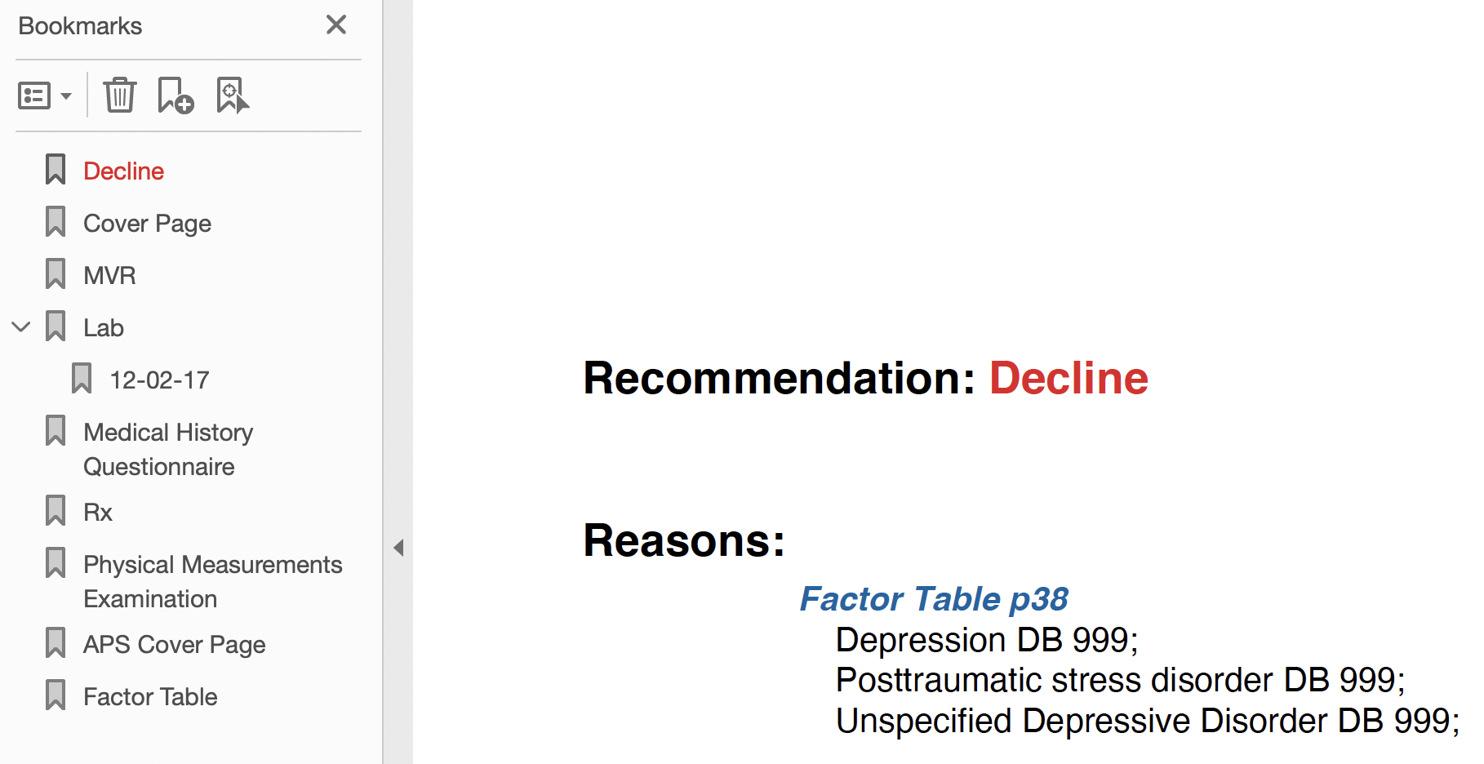
FAC Optimization Output
Recommendation and bookmarks

Slide 18
Scaling an OCR Solution

Slide 19
RGA’s First Foray into Machine Learning Assisted Underwriting
Cloud OCR
If your original slides weren’t built with master page text boxes, you may need to cut/paste content into the appropriate text boxes.
Expect to change font sizes to get your content to fit the new layouts.

Slide 20
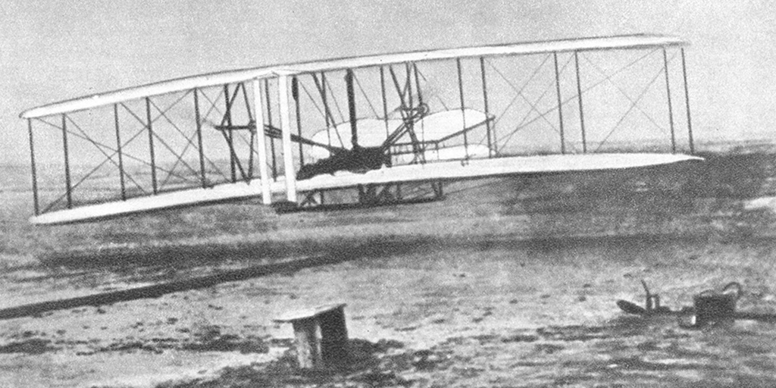

How do You Take a POC into Production
POC vs MVP vs Ongoing Production
Scaleable, Deployable Production
Proof of Concept (POC)

Slide 21
Architecture of RGA’s Initial Proof of Concept
Our POC accomplished the objective, but was not scalable
Components
Tesseract-OCR
Spark
Several Python NLP Libraries
Pain Points
Maintenance and planning of a Spark cluster
Elastic demand of underwriting cases
Costs associated with keeping individual processing nodes warm

Slide 22
Moving OCR to the Cloud for Scalability

Slide 23

Levels of Abstraction
How low a level of details do you want to accept?

Slide 24







Key Technologies
Serverless computing for scalability
AWS Elastic Compute Service (ECS)
AWS Lamda
AWS Textract
AWS S3
AWS Cloud Watch
Domino Datalab
Docker

Slide 25

AWS Textract
Overview
Textract is offered as a scalable service.
Scalability and capacity planning are AWS’s responsibility
Results from OCR are returned from AWS as a JSON file
Data from Returned from Textract
Raw text (x,y,h,w) tagged rectangles
Name-value pairs from forms
Collections of name-value pairs from tables
Data from Textract is fed to machine learning model
RGA IT is responsible for the AWS cloud-native Textract-centric ETL pipeline (Dev/ML-ops)
RGA data scientists produce the model, packaged as a Docker image
RGA Data Science team utilizes Domino Datalab to develop and deploy the model

Slide 26
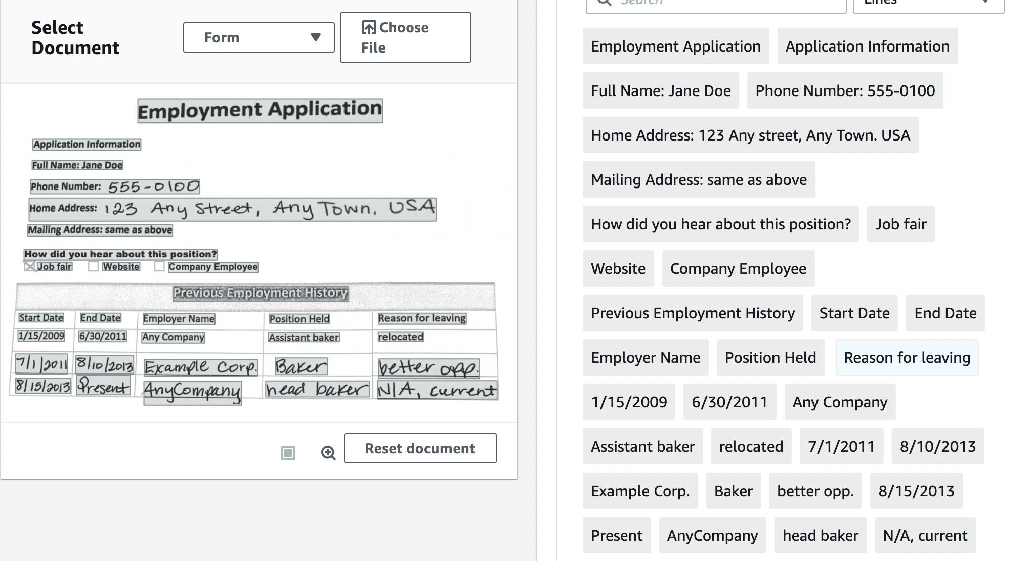
AWS Textract Output Data Formats
RAW text extraction

Slide 27
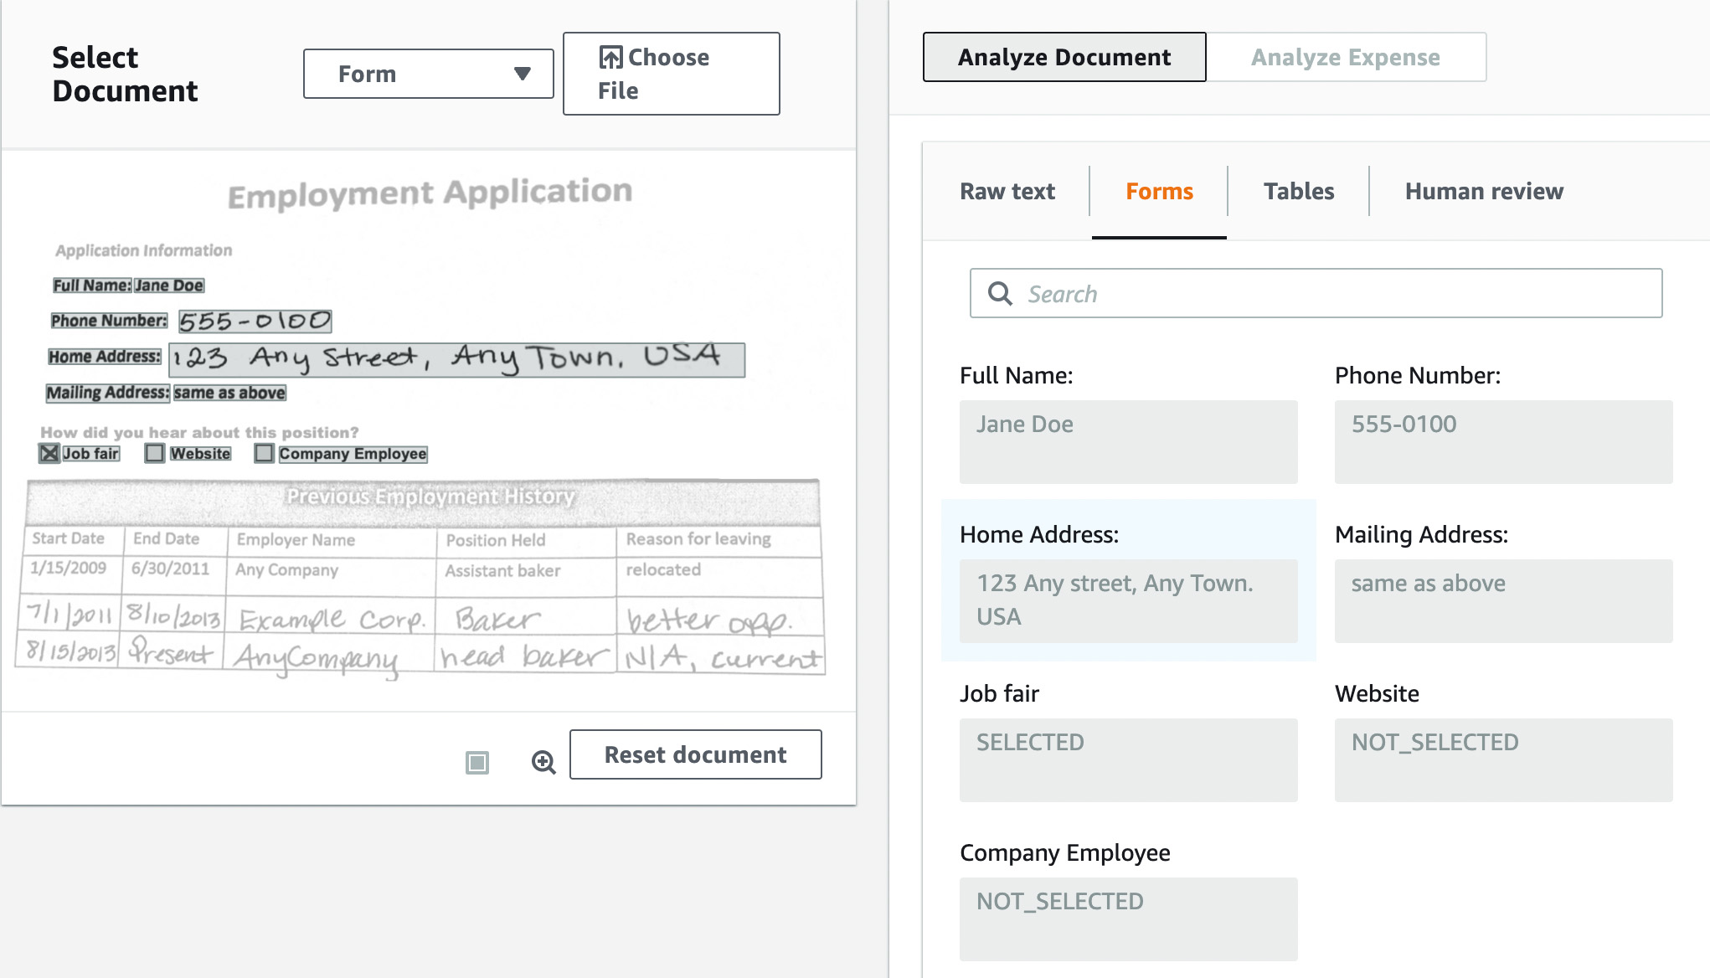
AWS Textract Output Data Formats
Name-value pair extraction

Slide 28
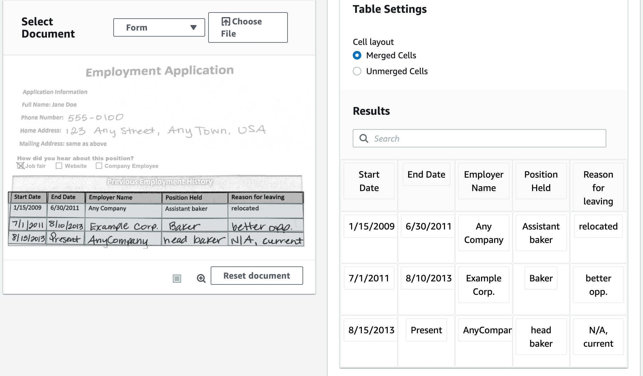
AWS Textract Output Data Formats
Table extraction

Slide 29
From Models to Docker Containers
Domino Datalab
Domino Datalab
MLOps platform that allows data scientists to develop models using Python/R/Scala, track experiments, and deliver models wrapped as RESTful APIs in Docker images
Based on Open Technologies
Docker
Kubernetes
Flask/Gunicorn
Domino Overview
Models built from proven tools such as PyTorch, TensorFlow/Keras, Scikit-Learn, Numpy, Scipy, etc.
Data scientists create project-specific
Domino can wrap models as scalable RESTful APIs
Models can be exported from Domino as Docker images

Slide 30
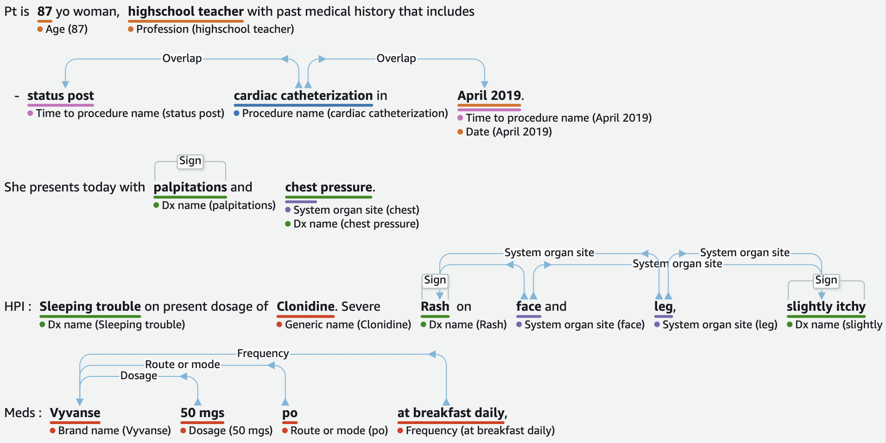
Future Technologies
Looking at AWS Medical Comprehend

Slide 31
Key Takeaways
Looking back to move forward
FAC Optimization System in production since December 2022
AWS Cloud-native technology integrated since rollout
System has proven scaleable and cost effective to varying demand loads
We will continue to enhance FAC Optimization looking to integrate newer AWS technologies
AWS was supportive as we chose technologies to implement this system

Slide 32

©2022 RGA. All rights reserved.
No part of this publication may be reproduced in any form without the prior permission of RGA.
The information in this publication is for the exclusive, internal use of the recipient and may not be relied upon by any other party other than the recipient and its affiliates, or published, quoted or disseminated to any party other than the recipient without the prior written consent of RGA.

